Slide 1
Portfolio Investment Plan (Finance and Risk Analytics)
Clients :
- Mr. Patrick Jyengar
- Mr. Peter Jyengar
Presented By :
Himanshu Dubey

Slide 2
Compound interest is the eighth wonder of the world. He who understands it, earns it. He who doesn’t, pays it.”
– Albert Einstein

Slide 3
Agenda
Objective
Stocks Overview
Analysis and Insights
Portfolio Analysis and Recommendations

Slide 4
Objective
Analyse a portfolio of stocks for investment management based on client’s requirement.
Provide consultation to two different investors, Mr. Patrick Jyenger and Mr. Peter Jyenger depending on their requirements and financial objectives.
Mr. Patrick Jyenger wants to invest $500K in equities and he expects double returns on his investment with low risk within a span of 5 years.
Mr. Peter Jyenger wants to invest his $1 million in equities and he is expecting high returns on his investment within 5 years by investing in high risk stocks.

Slide 5
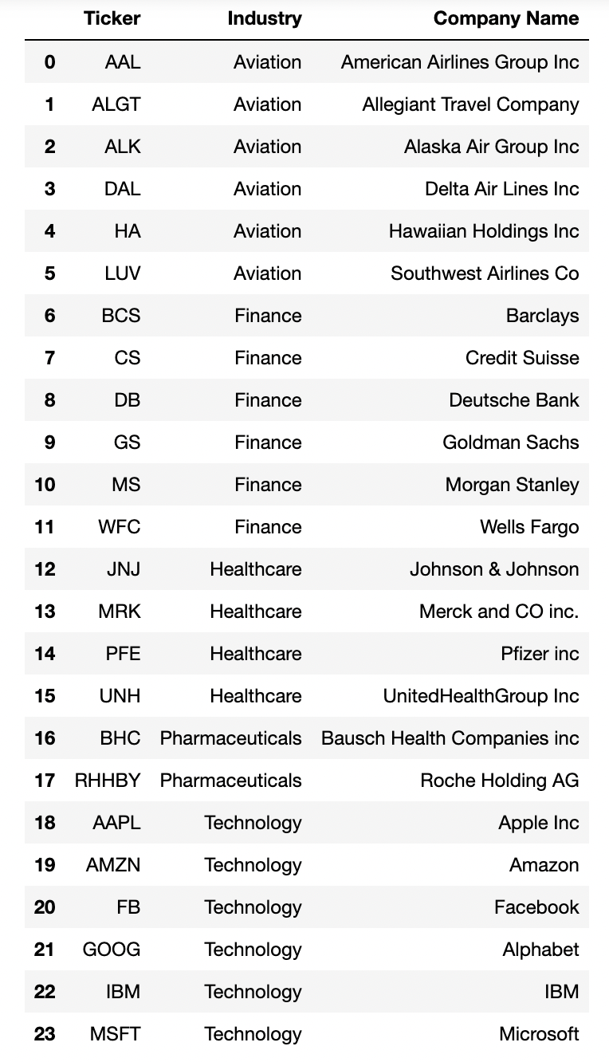
Stocks Overview
There are a total of 24 stocks.
These 24 stocks belong to specific sectors.
The sectors are Aviation, Finance, Healthcare, Pharmaceuticals, and Technology.
There are 6 stocks belonging to Aviation sector, 6 Finance sector stocks, 6 stocks that belong to Healthcare and Pharmaceuticals together, and 6 stocks belonging to Technology Sector.

Slide 6
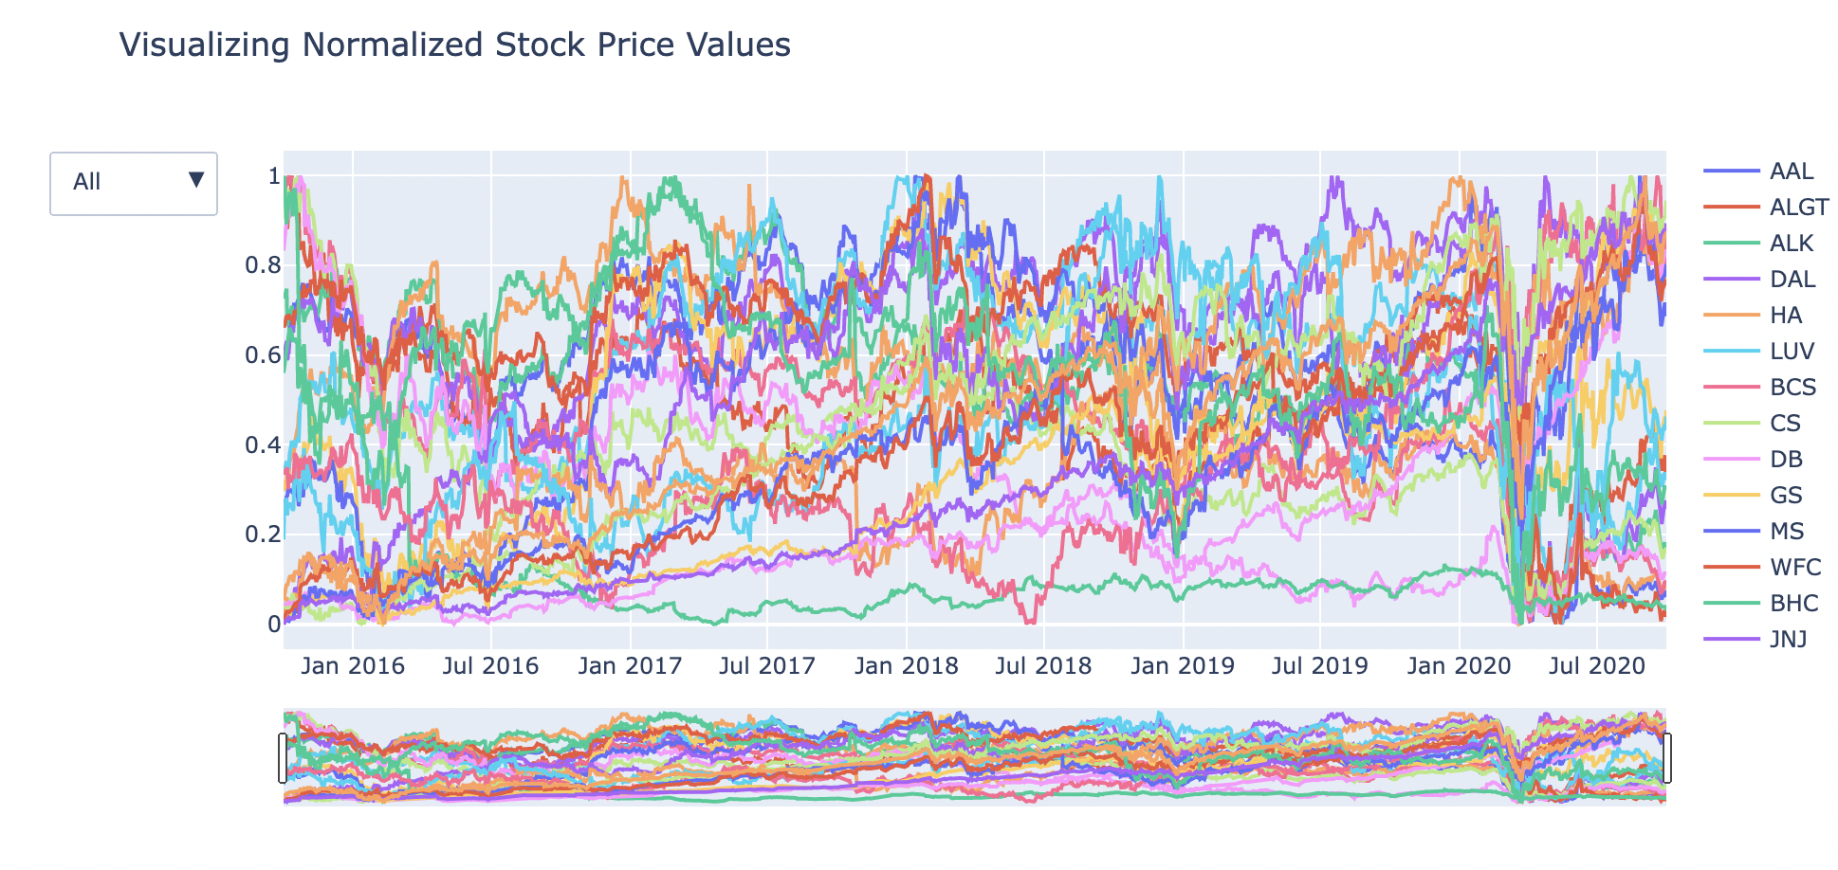
Market Performance Overview (Last 5 years)
The line chart show the stock performance of normalized stock prices over a given period of time and compared against S&P500 index.
The overall market performed well from Jan 2016 to Jan 2020.
The Market crashed in March 2020 due to the pandemic that affected the economy to slow down.

Slide 7
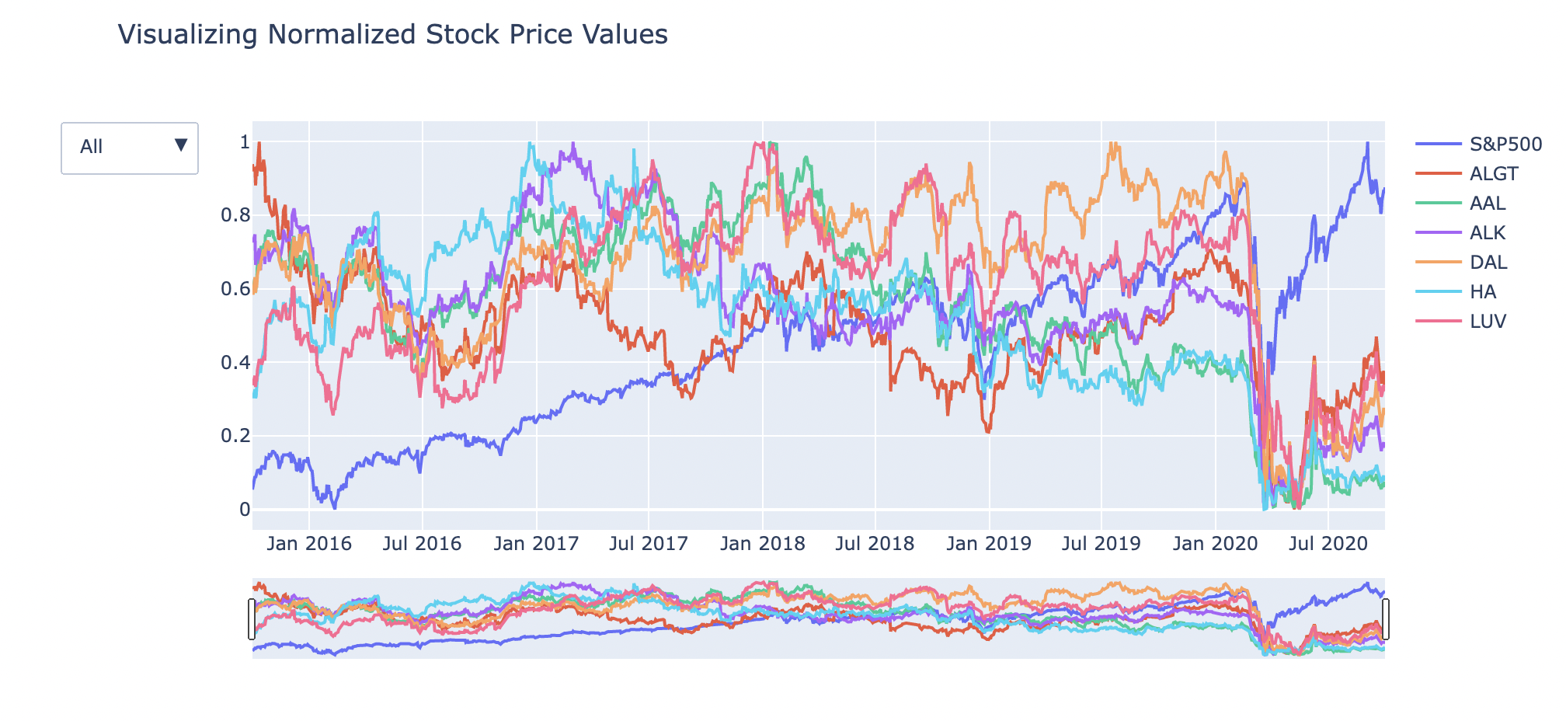
Aviation Sector (Last 5 years)
The travel restrictions imposed due to the Pandemic in March 2020 hit a real blow to the Aviation industry and the sector did not recover even though the market S&P500 index recovered and gone up.
If we look at the trends until Jan 2020, which is before the pandemic, almost all of the stocks were under performing as compared to S&P500.
However, Delta Airlines (DAL) and Southwest Airlines (LUV) stood out with good growth as compared to other Aviation stocks.

Slide 8
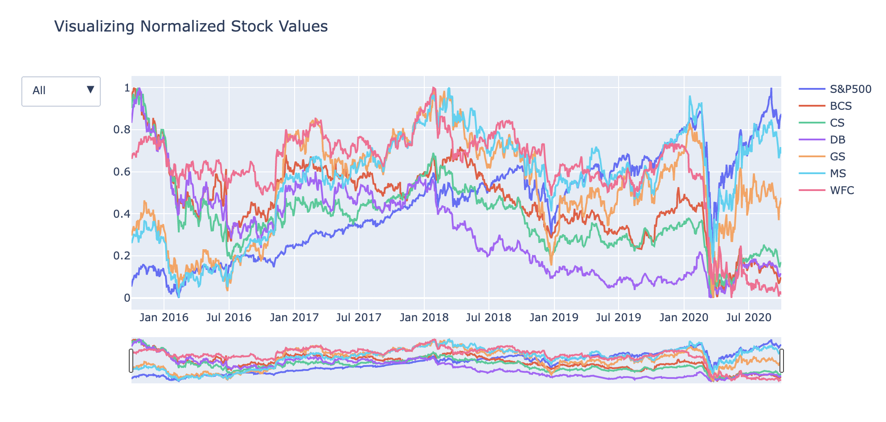
Finance Sector (Last 5 years)
Finance Sector gave a neutral performance over the last 5 years
This sector was also affected due to the pandemic in March 2020 but it has been on a path to recovery.
Morgan Stanley (MS) & Goldman Sachs (GS) have performed very well as compared to other stocks in the Finance sector.
Deutsche Bank (DB) was the only Finance Sector Stock that had been the worst performer during the last 5 years.

Slide 9
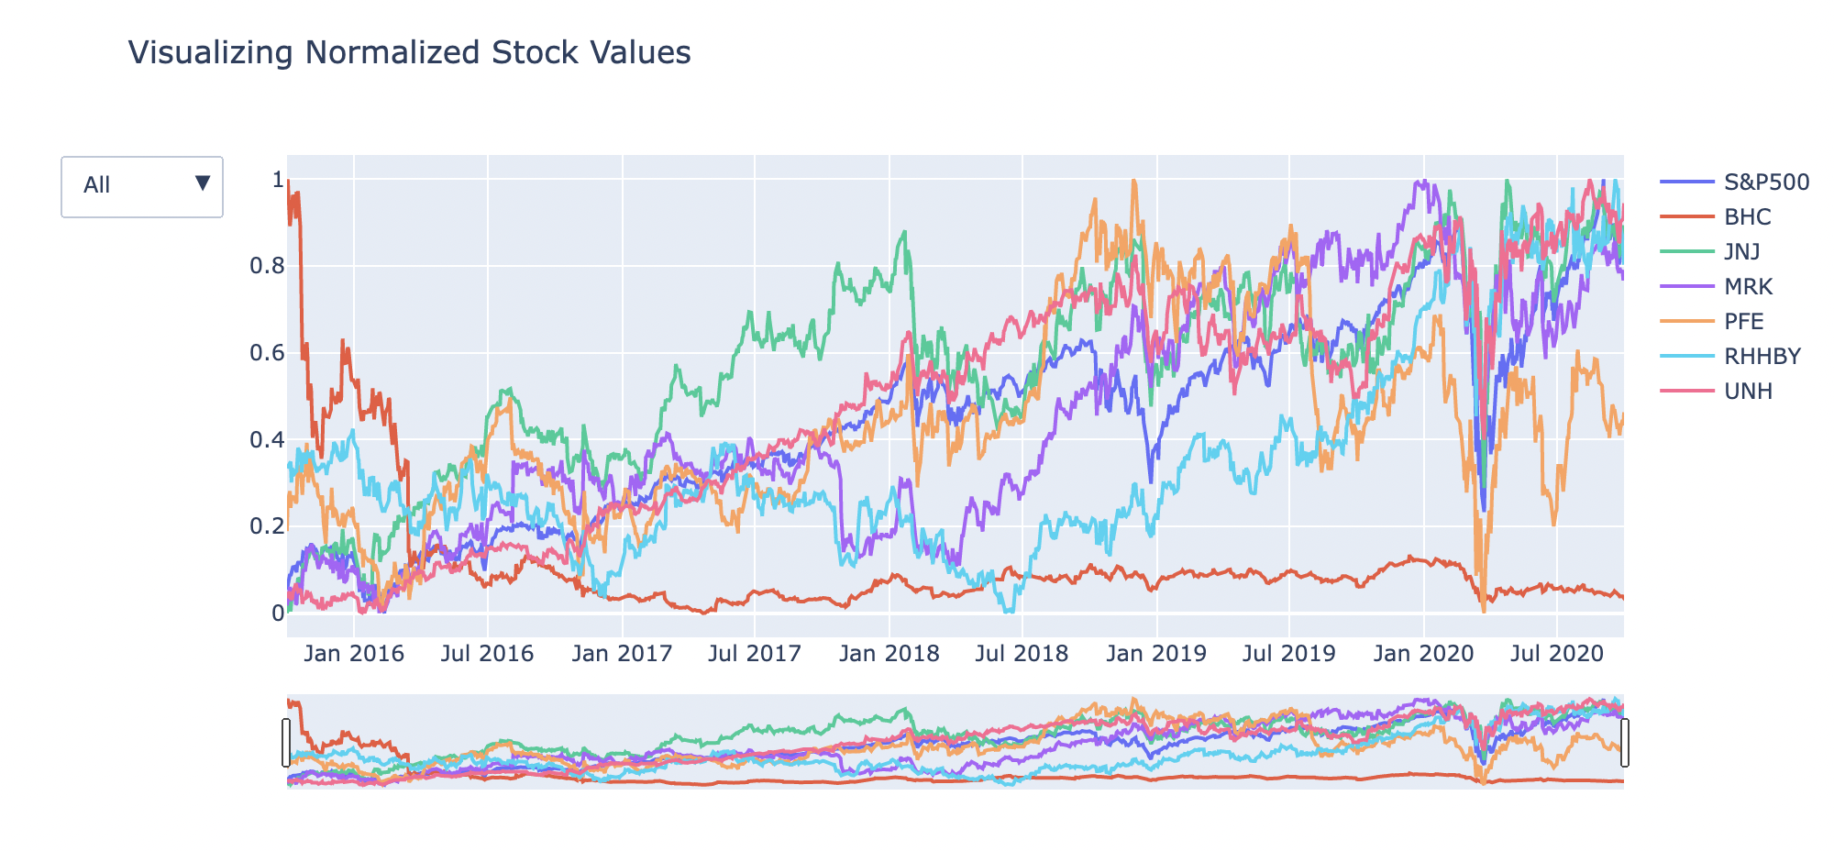
Healthcare and Pharma Sector (Last 5 years)
Healthcare and Pharma sector has shown a strong positive growth over the last 5 years.
Although the sector was affected due to the pandemic, but a good recovery was shown later.
United Health Group (UNH) and Johnson & Johsnson (JNJ) have performed very well during the period as compared to S&P500 Index.
Bausch Helath Companies (BHC) has consistently performed badly over the years when compared to other stocks in the healthcare and pharmaceuticals sectors together.

Slide 10
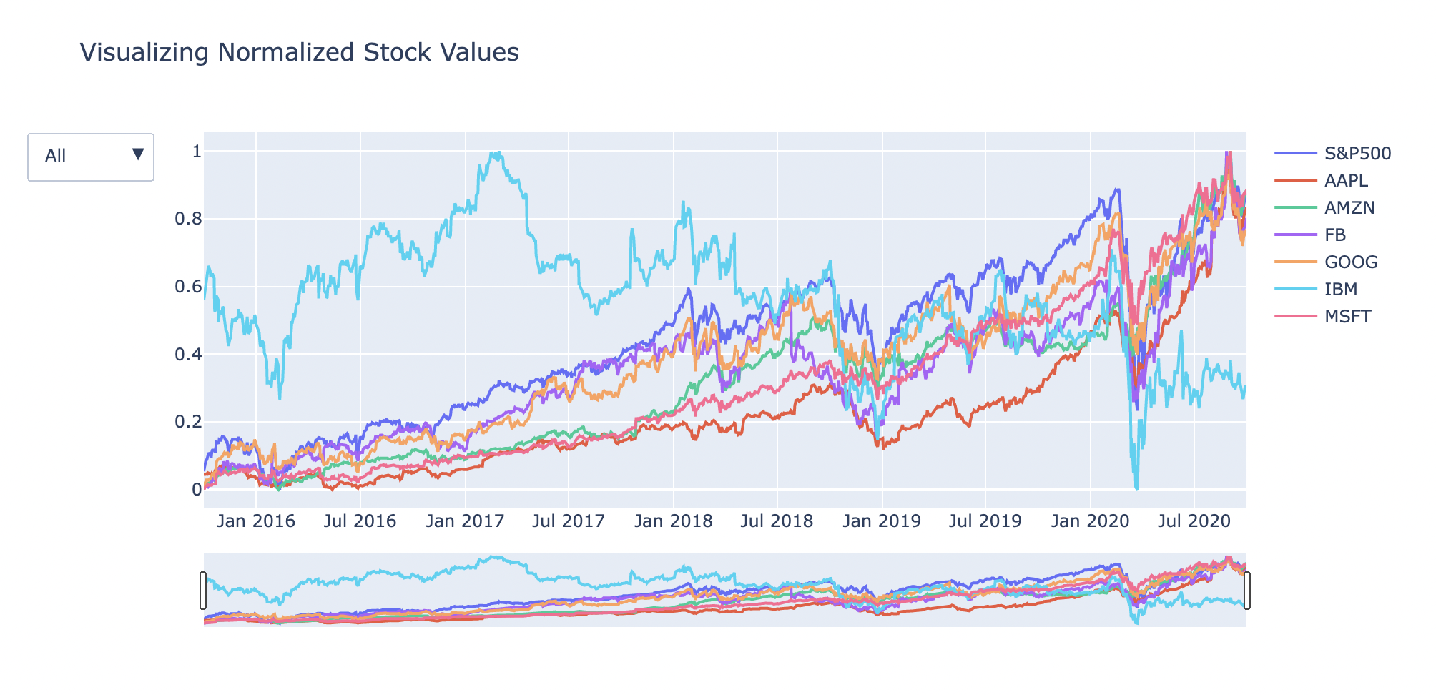
Technology Sector (Last 5 years)
Technology has been the best performing sector out of all the sectors in the last 5 years
This sector was also affected adversely due to the pandemic but it recovered at a fast pace.
Microsoft (MSFT), Amazon (AMZN), Apple (AAPL), Facebook (FB) & Google (GOOG) have performed positively along with S&P500 Market index.
IBM has been the worst performing technology stock as compared to all other technology sector stocks showing a downward trend during the period.

Slide 11
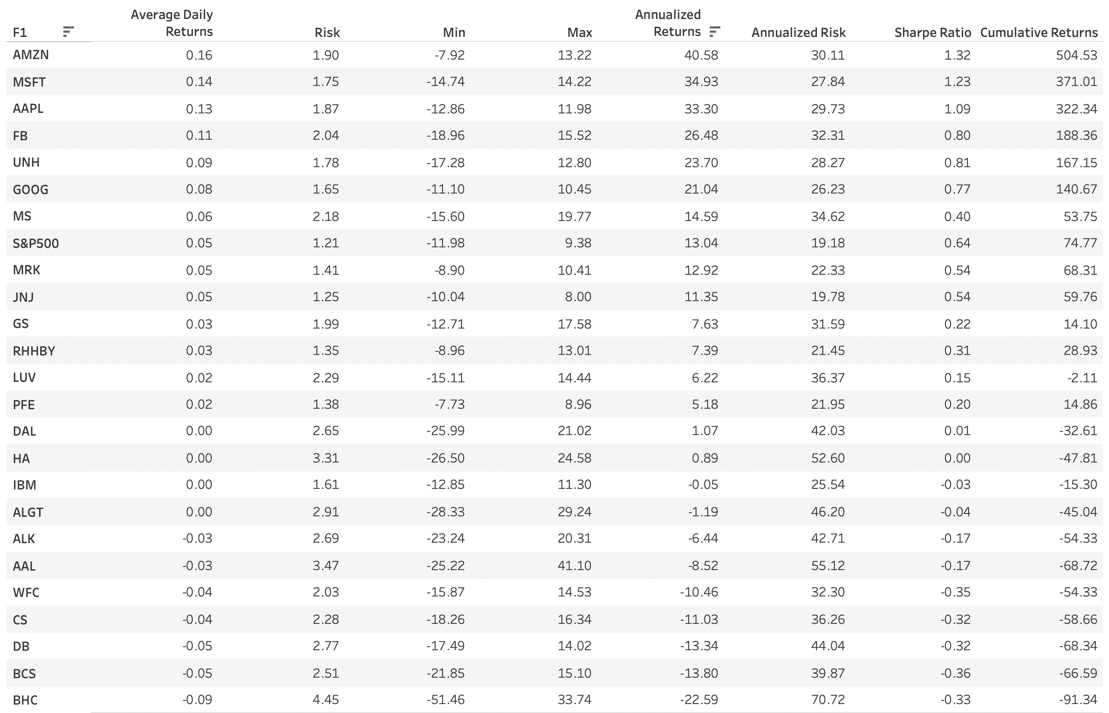
Annual Summary
Technology : Amazon (AMZN) - 40.58% annual returns
Technology : Microsoft (MSFT) - 34.93% annual returns
Technology : Apple (AAPL) - 33.30% annual returns
Technology : Facebook (FB) - 26.48% annual returns
Healthcare : UnitedHealthGroup (UNH) - 23.70% annual returns
Technology : Google (GOOG) - 21.04% annual returns
Finance : Morgan Stanley (MS) - 14.59% annual returns
S&P500 Index : 13.04% annual returns

Slide 12
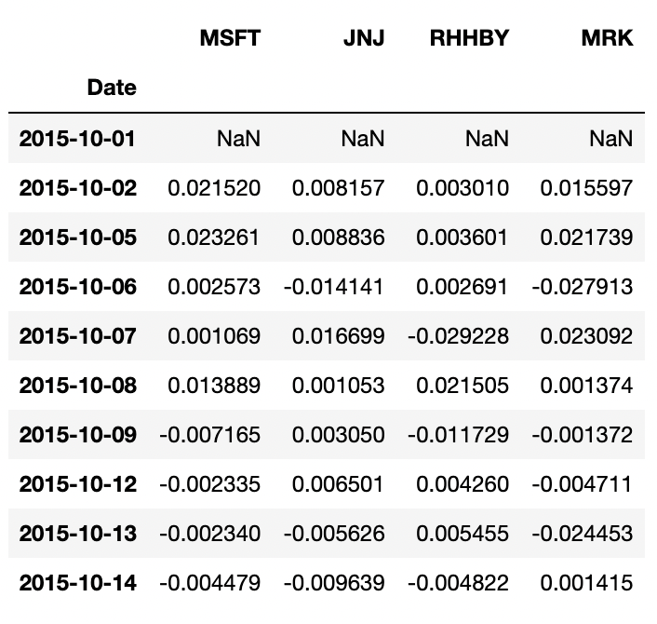
Mr. Patrick Jyengar’s Investment Goals
Mr. Patrick Jyengar wants to maintain a good standard of living after his retirement.
He has been a conservative investor during his life.
Has available capital of 1 Million dollars and wants to invest 500k dollars in a magazine (Naturo) for minority stake and remaining 500k dollars in equities.
He wants to double his invested amount in the span on 5 years.
He wants to invest in stocks with lower risk that would fetch him reasonable returns after 5 years.
As per his profile, Low risk stocks like Johnson and Johnson (JNJ), Roche Holding AG (RHHBY) and Merck and CO inc. (MRK) is suitable for investing.
These are low risk stocks but overall returns with these three stocks wouldn't help in reaching Mr. Patricks's investment goals.
Also, one portion of his wealth can be invested on Microsoft (MSFT) to gain the desired returns.

Slide 13
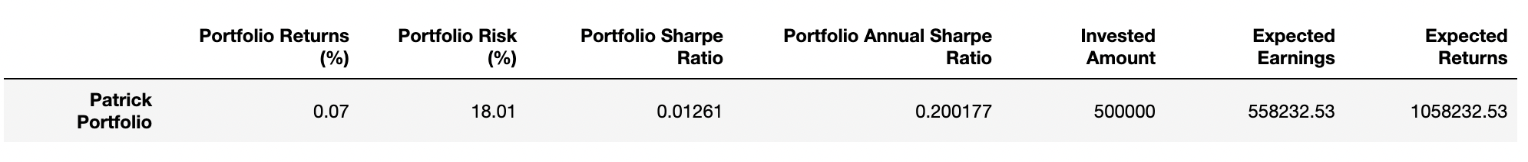
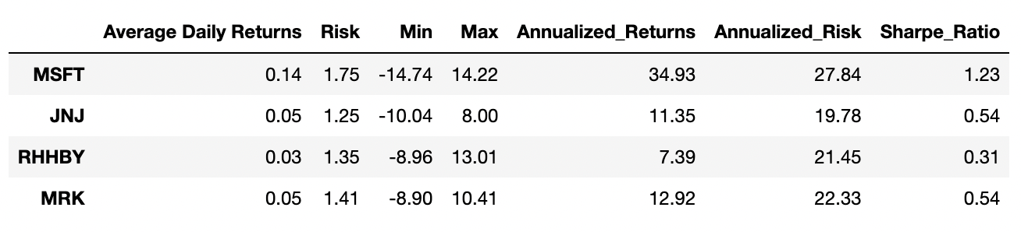
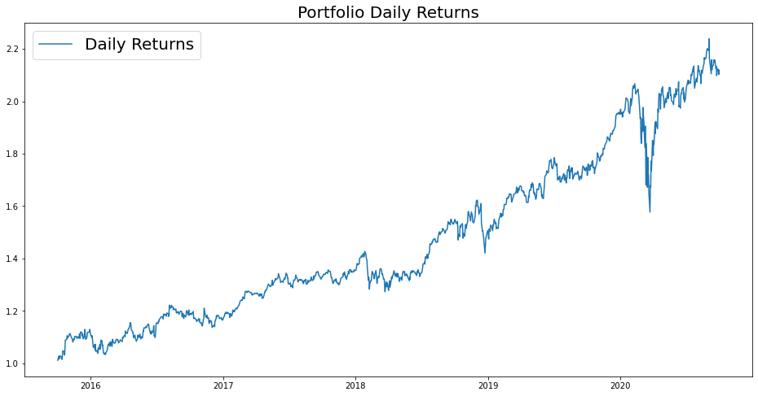
Mr. Patrick Jyengar’s Portfolio Analysis
The Daily Returns of the Portfolio is about 0.07% based on our stocks allocation.
The portfolio risk of the stocks allocated to Mr. Patrick is 18.01%.
Based on the stock allocations and calculations, if Mr. Patrick Jyengar invests 500,000 Dollars in the above Portfolio, the returns that he can expect after 5 years is 1.05 Million Dollars with 558 Thousand dollars of gain on investment.

Slide 14
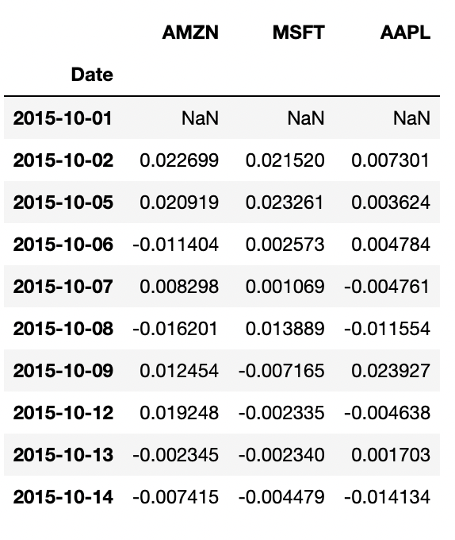
Mr. Peter Jyengar’s Investment Goals
Mr. Peter Jyengar wants to take risks and he prefers high-return on his investments.
He believes that he can still bounce back in case of any occasional losses.
He wants to invest the whole amount, which is 1 million dollars in stocks having highest margins and is expecting high returns on his investment within 5 years which will be further used for inorganic expansion of JWW.
For Mr. Peter Jyengar, we will be suggesting stocks offering high returns within 5 years irrespective of the risk.
High risk and High Returns stocks like Amazon (AMZN), Microsoft (MSFT), Apple (AAPL) are suitable for his profile.
These stocks would help him receive higher return on his investment

Slide 15
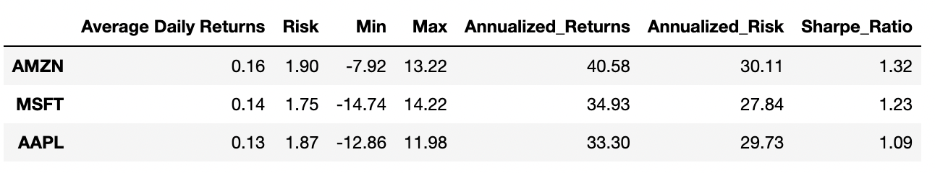
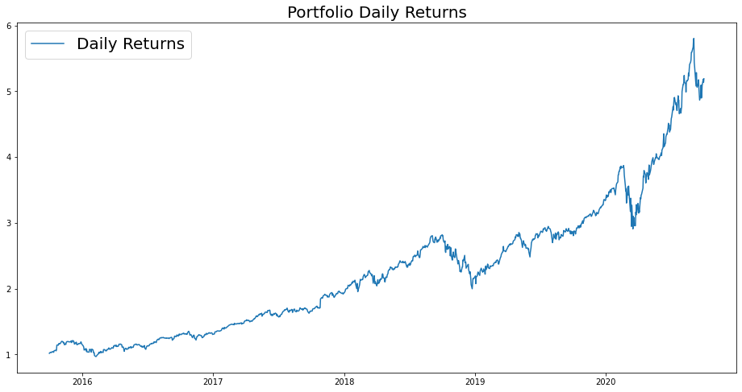
Mr. Peter Jyengar’s Portfolio Analysis
Total Daily Portfolio Returns of the stock allocation is 0.14%
The portfolio risk of the stocks allocated to Mr. Peter is 25.6%.
If Mr. Peter Jyengar invests 1 Million Dollars in the above Portfolio, the returns that he can expect after 5 years is around 5.1 Million Dollars with more than 4 Million dollars of gain on investment.

Slide 16
Thank You

